Slide 1

Section 2: Electric Fields

Slide 2
Activity: What is a Field?

Slide 3
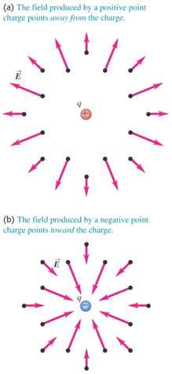
Electric Field and Force with Point Charges: Qualitative

Slide 4
Activity: Electric Field Checking the electric field representation of Coulomb’s Law

Slide 5
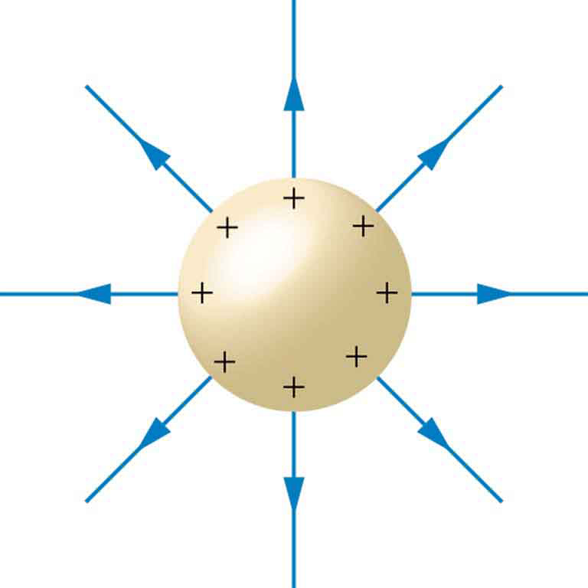
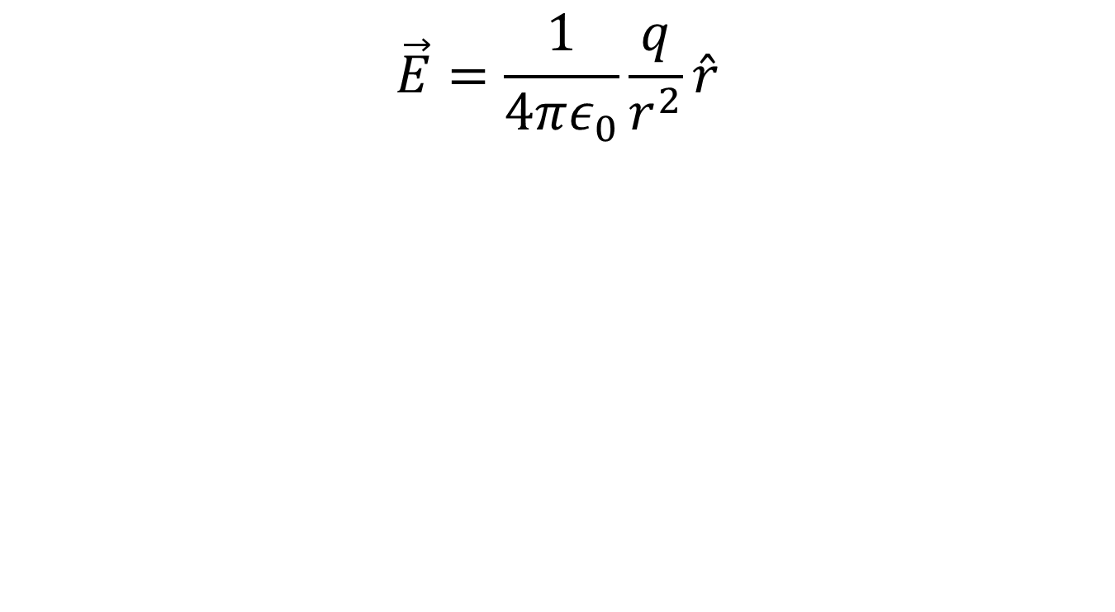
Electric Field due to a Point Charge: Quantitative
$$\vec{E}=\frac{1}{4πε_{0}}\frac{q}{r^{2}}\hat{r}$$

Slide 6
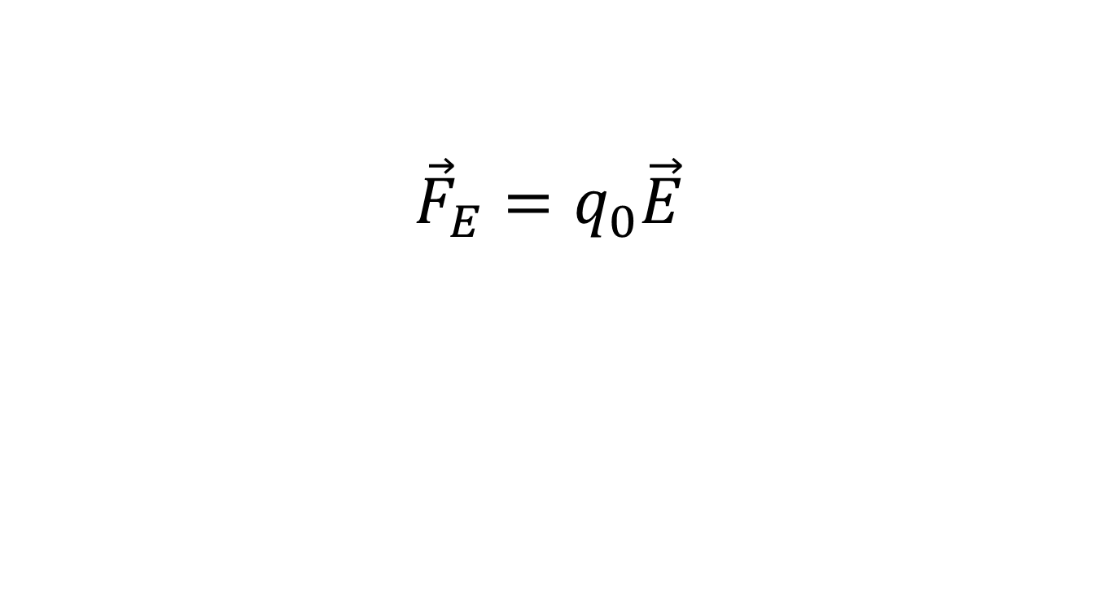
Electric Force on a Point Charge: Quantitative
$${\vec{F}}_{E}=q_{0}\vec{E}$$

Slide 7
Example Problem: Electric Field and Force for Point Charges

Slide 8
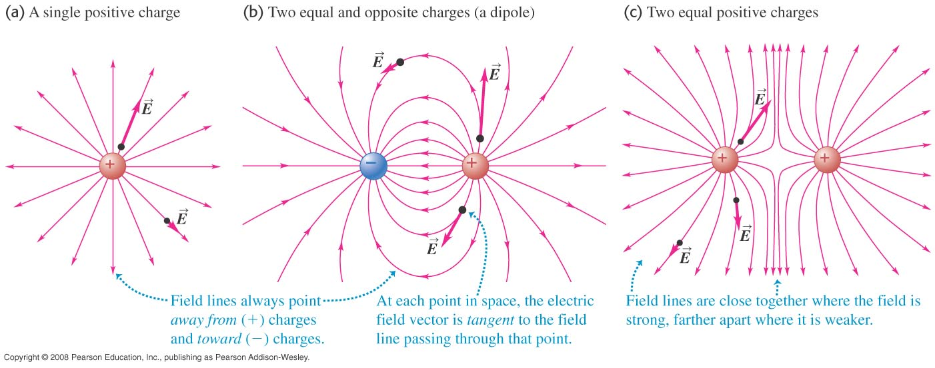
Electric Field Lines
“Maps” of electric field

Slide 9
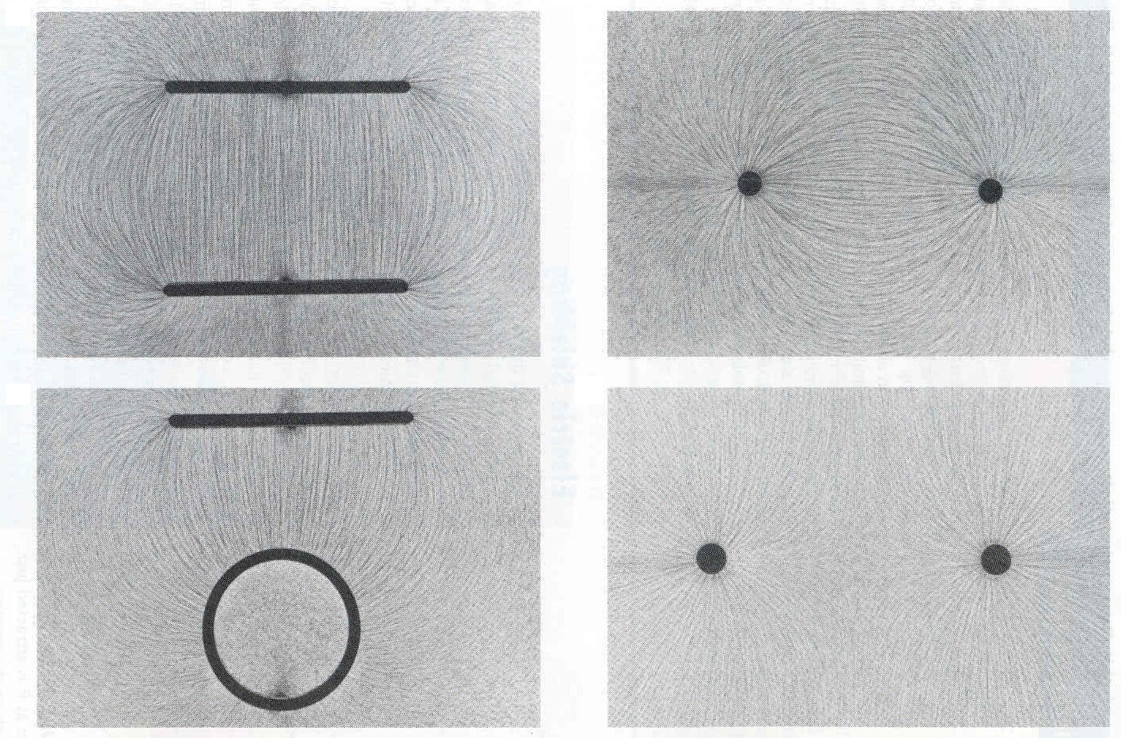
Some Electric Field Lines

Slide 10
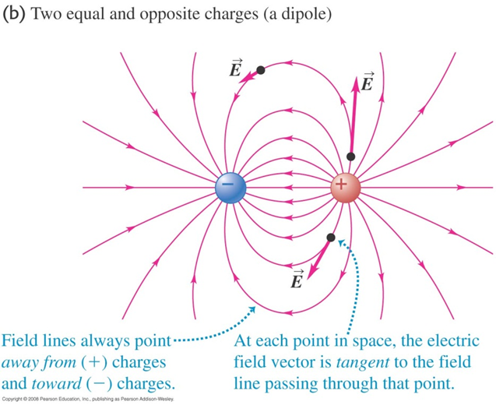
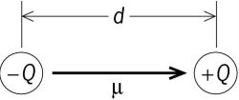
Dipoles: Two Opposite Charges

Slide 11
Activity: The Electric Field of a Dipole

Slide 12
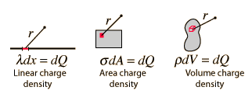
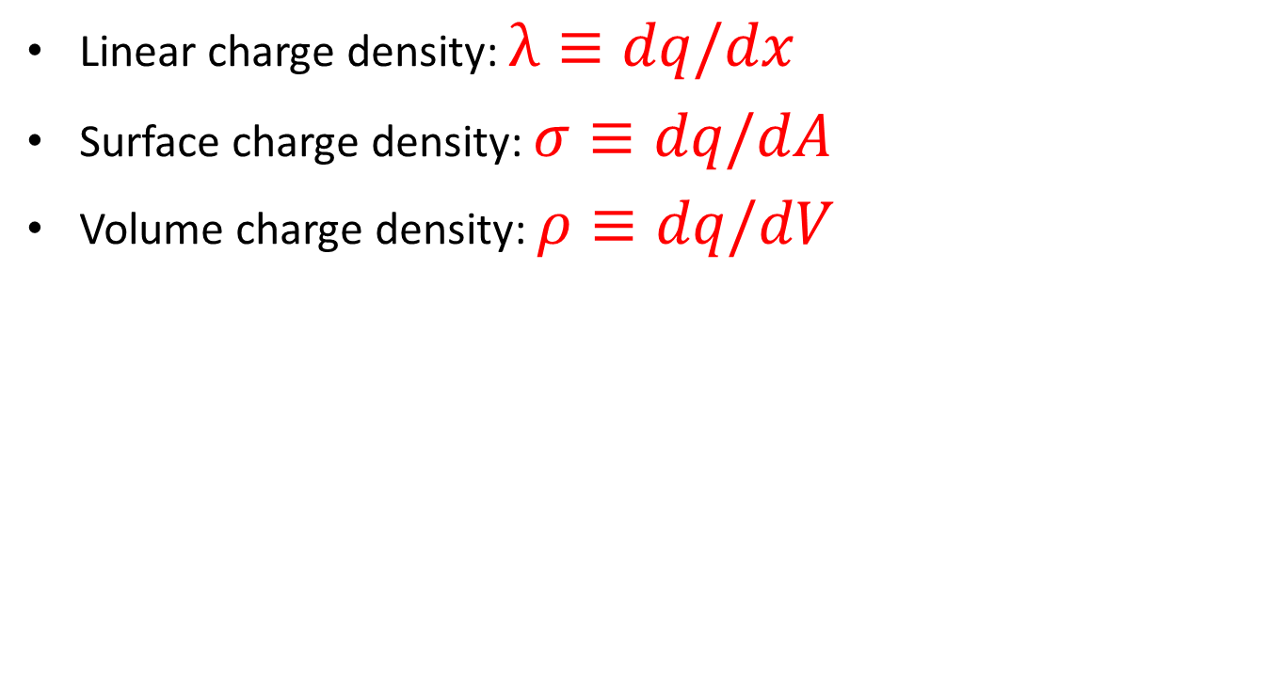
Continuous Distributions of Charge
Linear charge density: $λ≡dq/dx$
Surface charge density: $σ≡dq/dA$
Volume charge density: $ρ≡dq/dV$

Slide 13
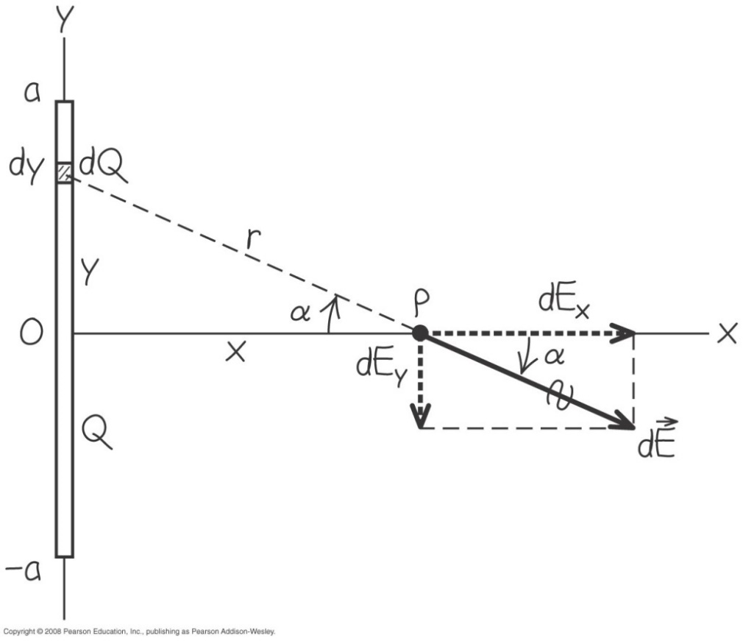
Example Problem: Line of Charge

Slide 14
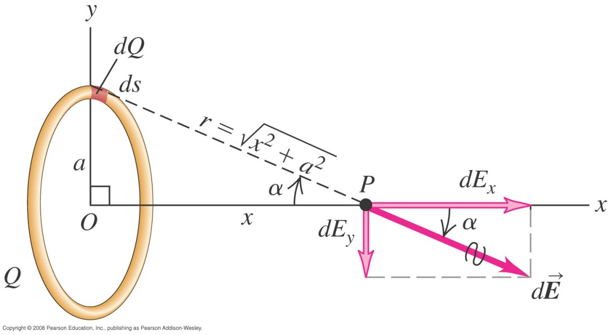
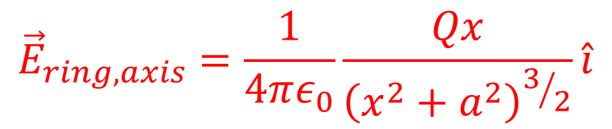
Ring of Charge
$${\vec{E}}_{ring,axis}=\frac{1}{4πε_{0}}\frac{Qx}{{\left(x^{2}+a^{2}\right)}^{3/2}}\hat{i}$$

Slide 15
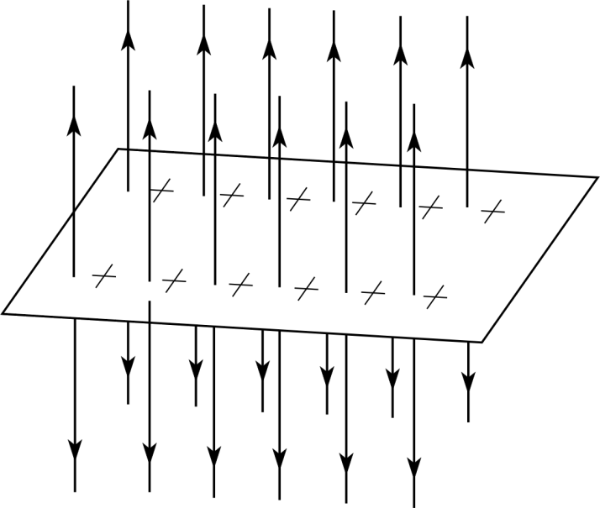
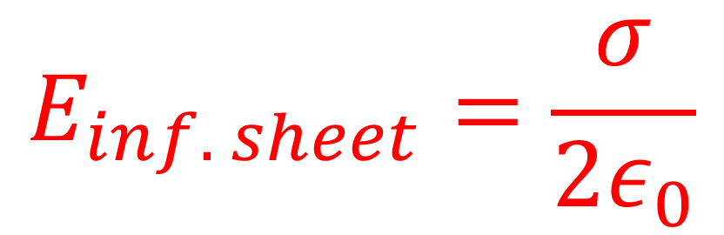
Infinite Sheet of Charge
$$E_{inf. sheet}=\frac{σ}{2ε_{0}}$$

Slide 16
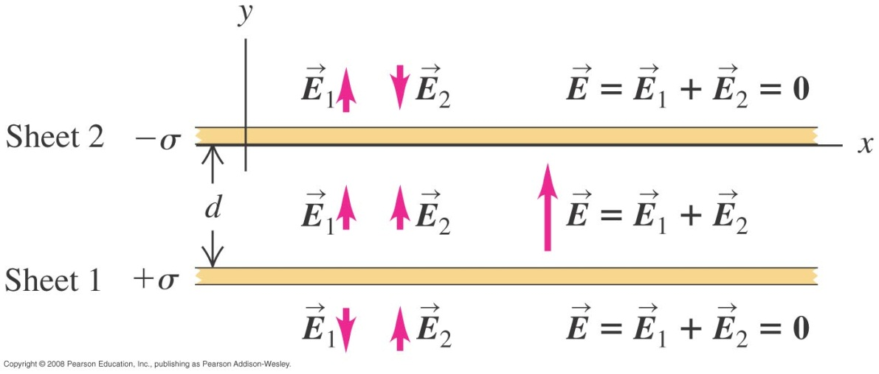
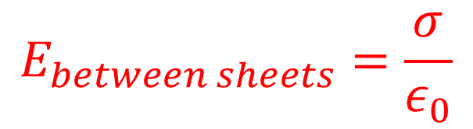
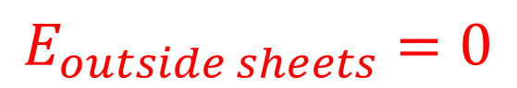
Parallel Plates
$$E_{between sheets}=\frac{σ}{ε_{0}}$$
$$E_{outside sheets}=0$$

